Slide 1
Memory Corruption Detecting Method Using Static Variables and Dynamic Memory Usage
Jihyun Park, Changsun Park, Byoungju Choi, Gihun Chang
{pola0527, ddangddon}@ewhain.net, bjchoi@ewha.ac.kr, gihun.chang@Samsung.com
Notes:
표지

Slide 2
Agenda
Memory Corruption
Related Work
Static memory corruption detection
Dynamic memory corruption detection
Our Method
Information tagging
Real-time memory defect detection
Signal hooking
Automation
Empirical study
Conclusion and future work

Slide 3
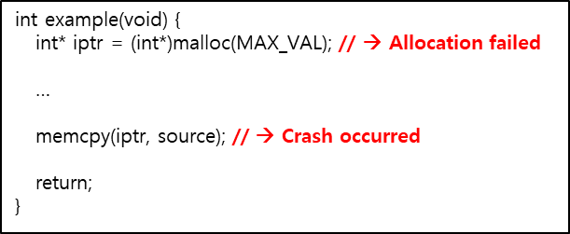
Memory corruption
Memory corruption is a fault in which the content of memory is changed unintentionally during the execution of program.
Once memory corruption occurs, the process either malfunctions or the system crashes.
Memory corruption is a defect that is difficult to resolve
Reason 1: There are often cases where the location of the cause of the memory corruption differs from the location of the actual failure
→ It is difficult to correlate the cause and effect
Reason 2: The symptoms of memory corruption are non-deterministic
→ The fault is not always reproduced
→ We propose a method to detect real time memory corruption by using static global variables and dynamic memory usage

Slide 4
Memory defect categories
Category | Defects
Allocation | Memory allocation failure Zero-size memory allocation Memory leak
Deallocation | Null pointer free (Compiler-dependent) Duplicated free Unallocated memory free Allocation/deallocation mismatch
Access | Null pointer access Freed memory access Unallocated memory access Access defects out of the allocated range that do not conflict with memory space of other variables Access defect out of the allocated range that conflicts with memory space of other variables

Slide 5
Related work
Static memory corruption detection
Analyze source codes
Analyze executable binaries without execution
Analyze to detect defects such as a buffer overflow
Limitation:
This method cannot detect memory corruption in dynamic memory
Defect detection accuracy is not very high
Dynamic memory corruption detection
Collects debugging information by adding tracking code into memory-related function
Compilation time
Runtime
Some popular tools: Purify, Memcheck, AddressSanitizer, …
operate in the actual execution environment
Highly accurate in the detection of memory corruption
Limitation
Performance overhead
Recompilation or change in the executable binary
Text (Code)
Data
Heap
Stack
<Linux Virtual Memory>

Slide 6
Information tagging
In order to detect memory defects in real-time, there must first be information that can determine the validity of the memory that will be used → shadow memory technique
To reduce the overhead from shadow memory, only the static global variables analyzed from the executable binary and dynamically allocated information on the heap memory area are managed through a data structure called ‘information tag’
Target System
Executable binary
Static variables
Information Tags
Repository
Process
Dynamic memory usage

Slide 7
Memory defect detection
To monitor memory usage, hooking is used for memory-related functions
void free(void *ptr)
{
s_informtag *tempTag = NULL;
if (g_pOrigFree == NULL) {
SoMain(); // Information Tagging Module initialization
return;
}
if(ptr == NULL) {
// Null pointer free
…
}
tempTag = InfoTag_Get(ptr);
if(tempTag == NULL) {
// Unallocated memory free if the information tag does not exist
…
}
if ((tempTag->Flag & 0x80) == 0x80) {
// Unallocated memory free if the information tag's allocation flag is set as static allocation
…
}
if ((tempTag->Flag & 0x18) > 0) {
// Allocation/deallocation mismatch if the information tag's allocation function type flag is set to type new/new[]
…
}
if ((tempTag->Flag & 0x01) == 0x01) {
// Duplicated free if the information tag's deallocation flag is set
…
}
// Update the information tag
InfoTag_Update((const void*)ptr, 2, (int)(tempTag->Flag |= 0x01));
InfoTag_Update(ptr, 4, (ADDR_TYPE)__builtin_return_address(0));
((void(*)(void*))g_pOrigFree)(ptr);
return;
}

Slide 8
Signal hooking
Some memory defects may cause system crashes
In order to detect defects without losing information when a system crashes, a signal handler that is raised during a crash is hooked
Signal related to memory defects
SIGSEGV
SIGABRT
SIGBUS

Slide 9
Automation Tool
ARM-based Linux system
Linux kernel 4.9.27
Executable binary analysis module
Extracts static global variables to store in information tag repository from the binary file
Defect detection module using information tagging
Detects defects using information tags each time a memory-related function is called
Crash monitoring module
Used the signal hooking to hook signal handlers and collect defect detection information without losing data
Result output module (Fault Detection)
Generates the results on defects that were detected in real-time
MCDT
Execution Binary Analysis
Run - Target Process
Fault Detection

Slide 10
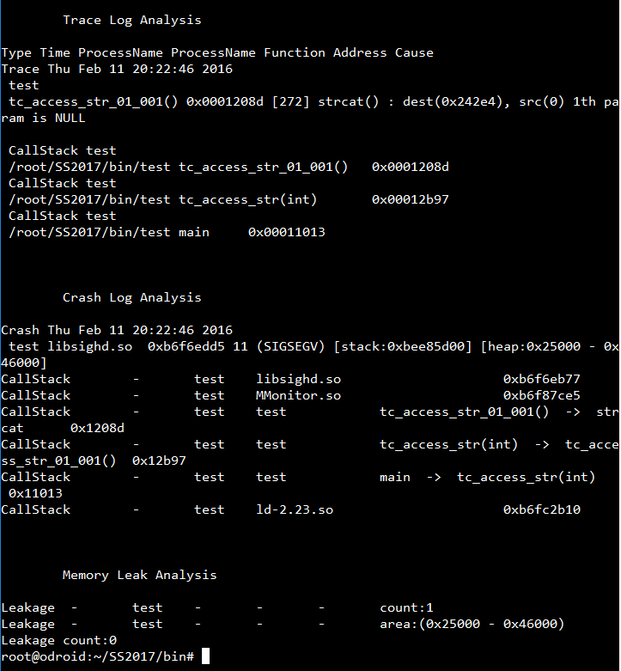
Automation Tool

Slide 11
Empirical study
ITC benchmark
A program that was developed for defects occurring in actual vehicle software
Contains a mix of various defects, such as deadlock and typecasting, memory defects
Fault |  | TC count | Crash occurrence |  | Fault |  | TC count | Crash occurrence
TC_02 | Buffer_overrun_dynamic | 32 | 1 |  | TC_29 | Memory_leak | 18 | 0
TC_03 | Buffer_underrun_dynamic | 39 | 3 |  | TC_31 | Null_pointer | 17 | 15
TC_04 | Cmp_funcadr | 2 | 0 |  | TC_32 | Overrun_st | 54 | 3
TC_11 | Deletion_of_data_structure_sentinel | 3 | 0 |  | TC_33 | Ow_memory | 2 | 0
TC_12 | Double_free | 12 | 12 |  | TC_42 | St_overflow | 7 | 7
TC_16 | Free_nondynamic_allocated_memory | 16 | 16 |  | TC_43 | St_underflow | 7 | 3
TC_17 | Free_null_pointer | 14 | 9 |  | TC_44 | Underrun_st | 13 | 0
TC_24 | Invalid_memory_access | 17 | 1 |  | TC_45 | Uninit_memory_access | 15 | 2
TC_25 | Littlemem_st | 11 | 4 |  | TC_46 | Uninit_pointer | 16 | 1
TC_28 | Memory_allocation_failure | 16 | 7

Slide 12
Results - All
Detection rate
Our tool detected 111 defects out of 311 defects
AddressSanitizer: 65 defects
Memcheck: 80 defects
Cause of defects
Our method accurately analyzed the cause of 94 defects (84.69%)
AddressSanitizer: 10 defects
Memcheck: 43 defects
(a) Detected Fault
(b) Fault Detection Accuracy

Slide 13
Results – Crash occurrence
Detection rate
Our tool detected 77 defects out of 84 defects
AddressSanitizer: 57 defects
Memcheck: 63 defects
Cause of defects
Our method accurately analyzed the cause of 58 defects (65.71%)
AddressSanitizer: 8 defects
Memcheck: 34 defects
(a) Fault Detection
(b) Fault Detection Accuracy

Slide 14
Performance
Monitoring overhead
Our method had a 6.67% performance overhead
AddressSanitizer: 26.7% performance overhead
Memcheck: heavyweight method

Slide 15
Conclusion and future work
Conclusion
Memory corruption is a remaining problem to be resolved
Defects must be detected across all memories used in a process
It is important to accurately identify the location of the cause of the defect instead of just the moment when the defect occurred
We proposed a method that detects memory corruption by analyzing static global variables and dynamic memory use
Future work
We will conduct further experimental study to measure the performance of our tool by fault injection
We plan to expand the static memory used for defect detection to the entire static memory area

